Slide 1
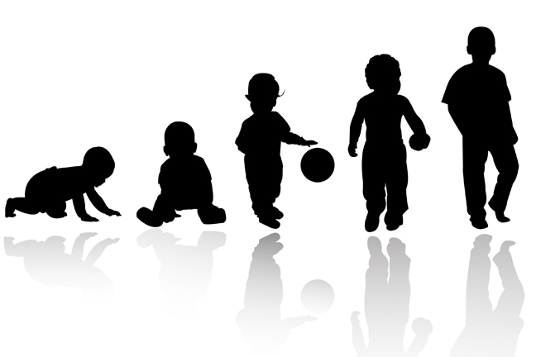
Maternal Deprivation: Genie The Wild Child Case Study
AEPSY Year 11 ATAR Psychology

Slide 2
Review
Summarise Bowlby’s maternal deprivation theory.
Give an example of a physical, cognitive and social-emotional milestone.
List the 5 stages of neuroplasticity

Slide 3
Learning Intentions
impact of enriched and deprived environments on development
case study – wild/feral child, such as Genie, the wild child

Slide 4
Success criteria
Define enrichment and deprivation
List milestones or cognitive Piagetian tests that Genie was unable to perform due to her deprivation
Explain how the Genie case study provide evidence for and against Bowlby’s Attachment Theory
List examples of enrichment

Slide 5


Slide 6
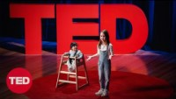

Slide 7
Success criteria
Define enrichment and deprivation
List milestones or cognitive Piagetian tests that Genie was unable to perform due to her deprivation
Explain how the Genie case study provide evidence for and against Bowlby’s Attachment Theory
List examples of enrichment

